Slide 1
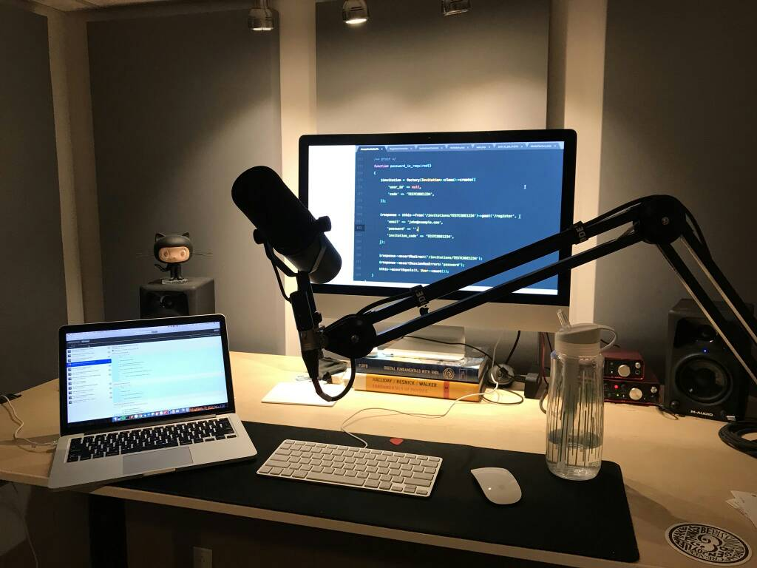
Software Development General Art

Slide 2
Introduction to Software Engineering.
What is Software?: Computer Programs and associated documentation such as requirements, design models and user manual.
Software products may be :
Generic - developed to be sold to a range of different customers e.g. PC software such as Excel or Word.
2. Custom - developed for a single customer according to their specification. New software can be created by developing new programs, configuring generic software systems or reusing existing software.
Notes:
Computer programs and associated documentation such as requirements, design models and user manuals.

Slide 3
What is Software Engineering?
Software engineering is an engineering branch associated with development of software product using well-defined scientific principles, methods and procedures.
Software engineering is an engineering discipline that is concerned with all aspects of software production.
***Essential Software product attributes are maintainability, dependability, efficiency and usability.
Notes:
Software engineering is an engineering branch associated with development of software product using well-defined scientific principles, methods and procedures

Slide 4
Software Development Process
In software engineering, a software development process is the process of dividing software development work into distinct phases to improve design, product management, and project management. It is also known as a software development life cycle

Slide 5
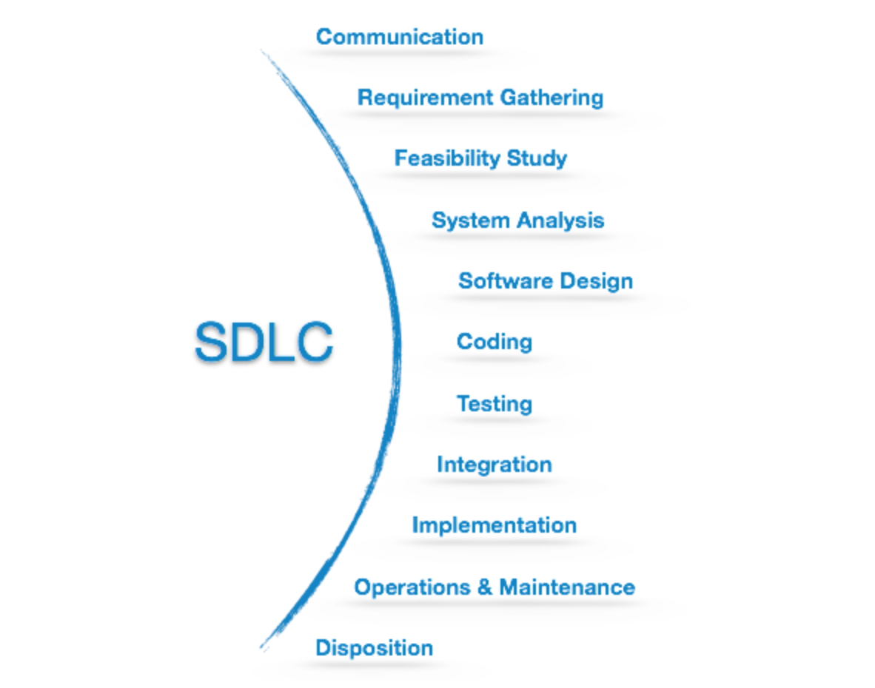
SDLC framework includes the ff steps.

Slide 6
SDLC Activities
Communication: This is the first step where the user initiates the request for a desired software product. He contacts the service provider and tries to negotiate the terms. He submits his request to the service providing organization in writing.
Requirement Gathering: This step onwards the software development team works to carry on the project. The team holds discussions with various stakeholders from problem domain and tries to bring out as much information as possible on their requirements. The requirements are contemplated and segregated into user requirements, system requirements and functional...

Slide 7
requirements. The requirements are collected using a number of practices as given -
studying the existing or obsolete system and software,
conducting interviews of users and developers,
referring to the database or
collecting answers from the questionnaires
Feasibility studies: After requirement gathering, the team comes up with a rough plan of software process. At this step the team analyzes if a software can be made to fulfill all requirements of the user and if there is any possibility of software being no more useful. It is found out, if the project is financially, practically and technologically feasible for the organization to take up.

Slide 8
There are many algorithms available, which help the developers to conclude the feasibility of a software project.
System Analysis: At this step the developers decide a roadmap of their plan and try to bring up the best software model suitable for the project. System analysis includes Understanding of software product limitations, learning system related problems or changes to be done in existing systems beforehand, identifying and addressing the impact of project on organization and personnel etc. The project team analyzes the scope of the project and plans the schedule and resources accordingly.

Slide 9
Software Design: Next step is to bring down whole knowledge of requirements and analysis on the desk and design the software product. The inputs from users and information gathered in requirement gathering phase are the inputs of this step. The output of this step comes in the form of two designs; logical design and physical design. Engineers produce meta-data and data dictionaries, logical diagrams, data-flow diagrams and in some cases pseudo codes.
Coding: This step is also known as programming phase. The implementation of software design starts in terms of writing program code in the suitable programming language and developing error-free executable programs efficiently.

Slide 10
Testing: An estimate says that 50% of whole software development process should be tested. Errors may ruin the software from critical level to its own removal. Software testing is done while coding by the developers and thorough testing is conducted by testing experts at various levels of code such as module testing, program testing, product testing, in-house testing and testing the product at user’s end. Early discovery of errors and their remedy is the key to reliable software.
Integration: Software may need to be integrated with the libraries, databases and other program(s). This stage of SDLC is involved in the integration of software with outer world entities.

Slide 11
Implementation:This means installing the software on user machines. At times, software needs post-installation configurations at user end. Software is tested for portability and adaptability and integration related issues are solved during implementation.
Operation and maintenance: This phase confirms the software operation in terms of more efficiency and less errors. If required, the users are trained on, or aided with the documentation on how to operate the software and how to keep the software operational. The software is maintained timely by updating the code according to the changes taking place in user end environment or technology. This phase may face challenges from hidden bugs and real-world unidentified problems.

Slide 12
Disposition: As time elapses, the software may decline on the performance front. It may go completely obsolete or may need intense upgradation. Hence a pressing need to eliminate a major portion of the system arises. This phase includes archiving data and required software components, closing down the system, planning disposition activity and terminating system at appropriate end-of-system time.
Now the traditional SDLC has been replaced with agile development SCRUM - use of an adaptive lifecycle instead of a predictive one.
Not all software projects can be built using the SCRUM approach.

Slide 13
Object Oriented Programming(OOP)
Object-oriented programming (OOP) is a programming paradigm based on the concept of “objects”, which may contain data, in the form of fields, often known as attributes; and code, in the form of procedures, often known as methods. A feature of objects is that an object’s procedures can access and often modify the data fields of the object with which they are associated (objects have a notion of “this” or “self”).
In OOP, computer programs are designed by making them out of objects that interact with one another.Significant object-oriented languages include Java, C++, C#, Python, PHP, Ruby, Perl, Object Pascal, Objective-C, Dart, Swift, Scala, Common Lisp

Slide 14
The important features of object–oriented programming are −
Bottom–up approach in program design
Programs organized around objects, grouped in classes
Focus on data with methods to operate upon object’s data
Interaction between objects through functions
Reusability of design through creation of new classes by adding features to existing classes.

Slide 15
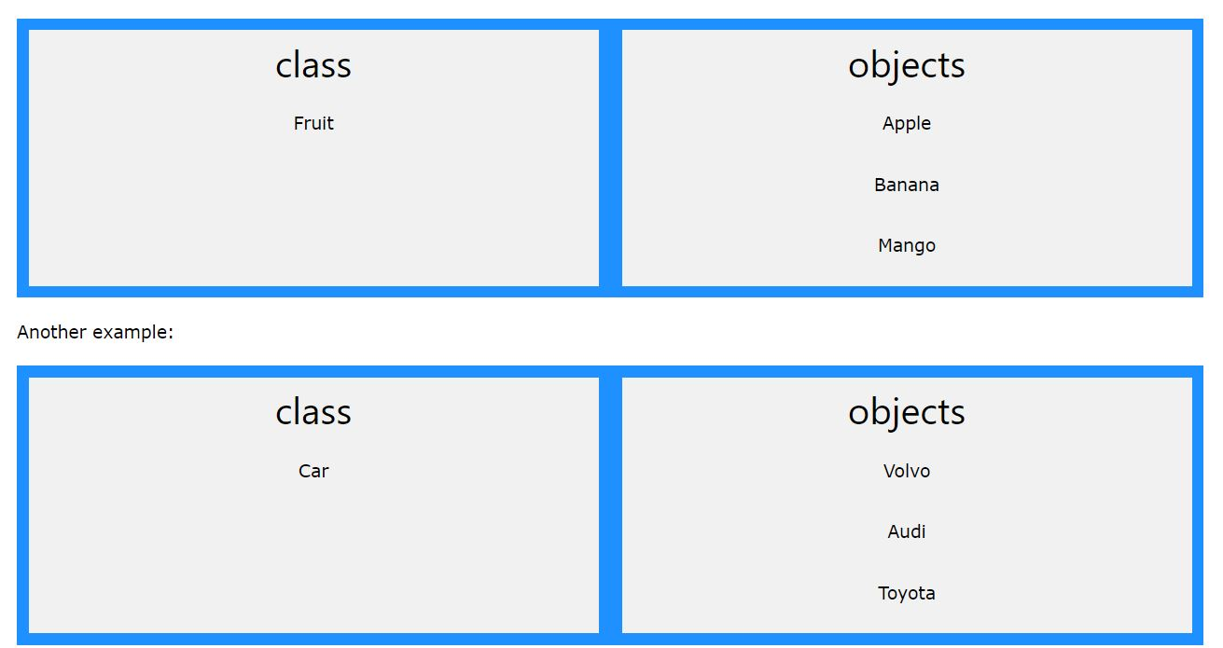

Slide 16
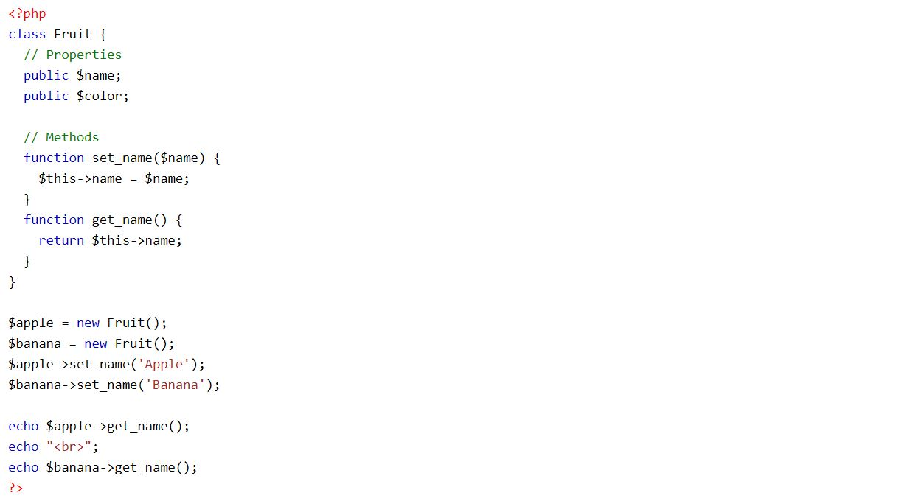

Slide 17
Software Architecture Pattern
An architectural pattern is a general, reusable solution to a commonly occurring problem in software development within a given context. Architectural patterns and software design pattern are often used interchangeably.
Layered pattern
Client-server pattern
Master-slave pattern
Pipe-filter pattern
Broker pattern
Peer-to-peer pattern
Event-bus pattern
Model-view-controller pattern
Blackboard pattern
Interpreter pattern

Slide 18
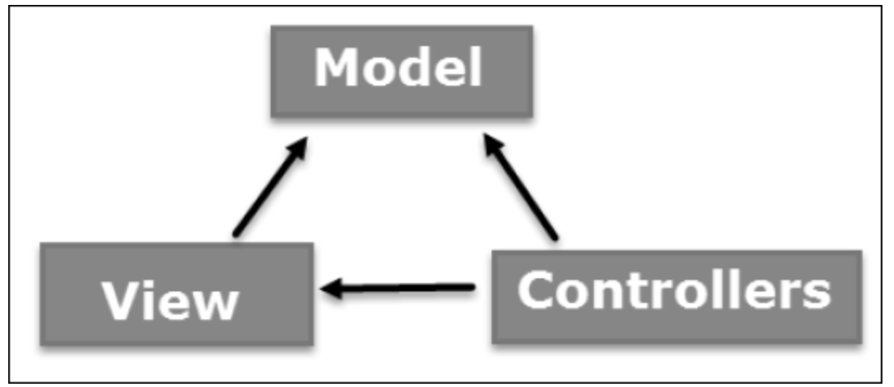
What is MVC?
The Model-View-Controller (MVC) is an architectural pattern that separates an application into three main logical components: the model, the view, and the controller. Each of these components are built to handle specific development aspects of an application. MVC is one of the most frequently used industry-standard web development framework to create scalable and extensible projects.

Slide 19
Model: The Model component corresponds to all the data-related logic that the user works with. This can represent either the data that is being transferred between the View and Controller components or any other business logic-related data. For example, a Customer object will retrieve the customer information from the database, manipulate it and update it data back to the database or use it to render data.
View: The View component is used for all the UI logic of the application. For example, the Customer view will include all the UI components such as text boxes, dropdowns, etc. that the final user interacts with.

Slide 20
Controller: Controllers act as an interface between Model and View components to process all the business logic and incoming requests, manipulate data using the Model component and interact with the Views to render the final output. For example, the Customer controller will handle all the interactions and inputs from the Customer View and update the database using the Customer Model. The same controller will be used to view the Customer data.
Popular Web application frameworks that make use of MVC are:
Laravel – PHP, CakePHP – PHP, Django – python, ASP.NET MVC

Slide 21
References
https://www.veracode.com/security/software-development-lifecycle
http://whatis.techtarget.com/reference/Learn-IT-Software-development
http://er.yuvayana.org/quality-software-attributes-characteristics-of-good-software-products/
https://www.quora.com/What-are-quality-attributes-of-a-good-software
https://towardsdatascience.com/10-common-software-architectural-patterns-in-a-nutshell-a0b47a1e9013

